Slide 1
How to Setup GitHub Desktop
By Ben Canwell

Slide 2
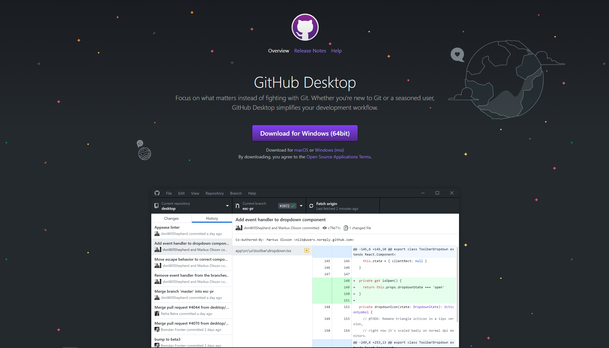
Step 1:
Download GitHub desktop.
https://desktop.github.com/

Slide 3
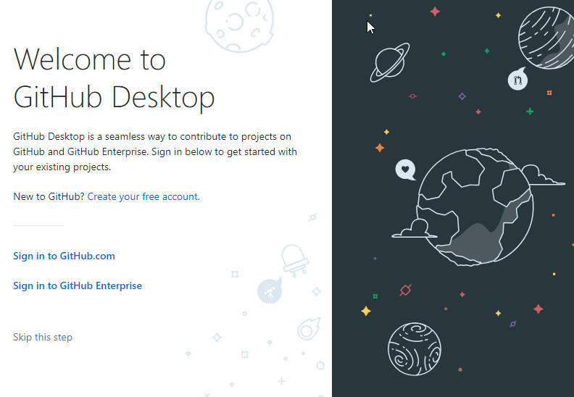
Step 2:
Create a GitHub account if you don't have one.
This can be done through the GitHub website or GitHub Desktop.

Slide 4
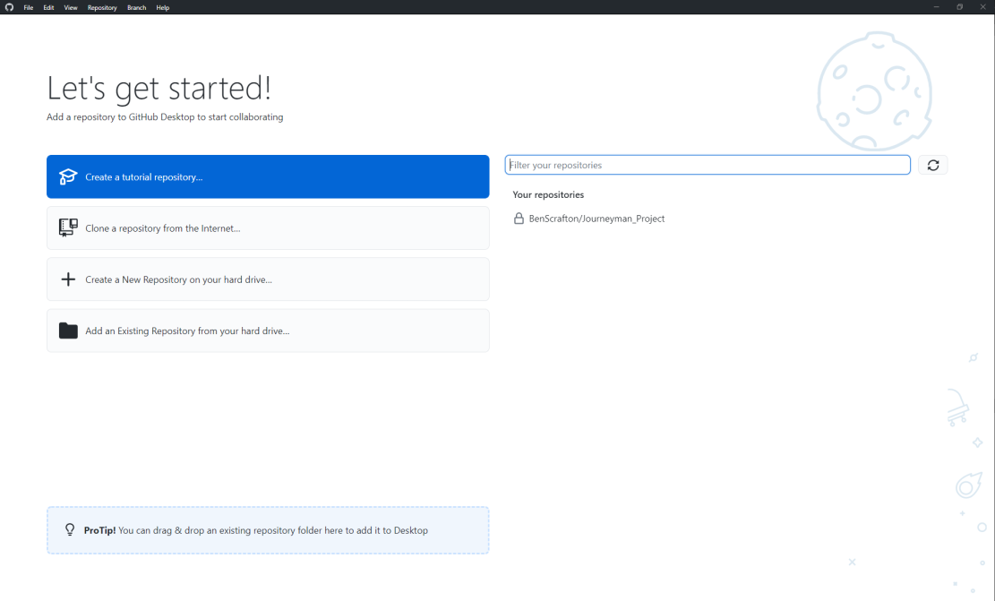
Step 3:
To get access to the group project press current repository so it turns white.
Press add, clone repository.

Slide 5
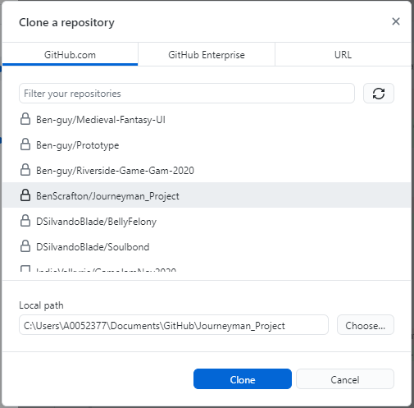
Step 4:
Select Journeyman_Project so the local path changes and press clone.

Slide 6
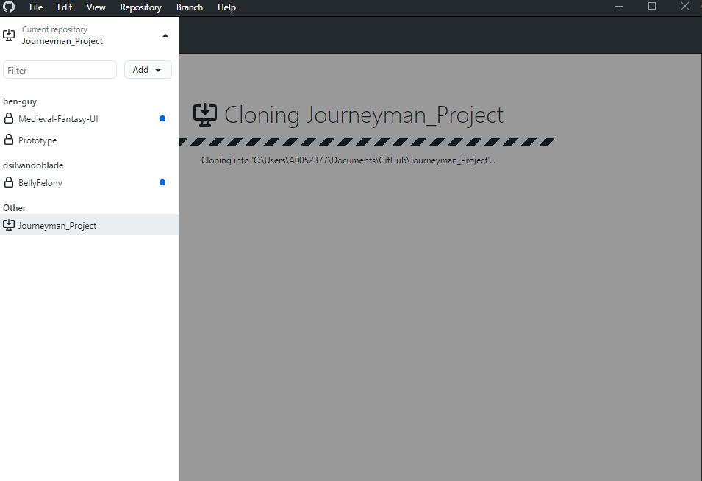
Step 5:
Wait for the files to download.

Slide 7
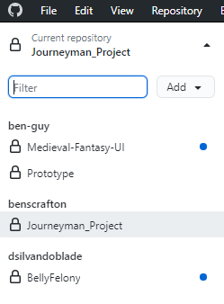
Step 6:
After the download is done the repository should be in the current repository.

Slide 8
How to use GitHub Desktop

Slide 9
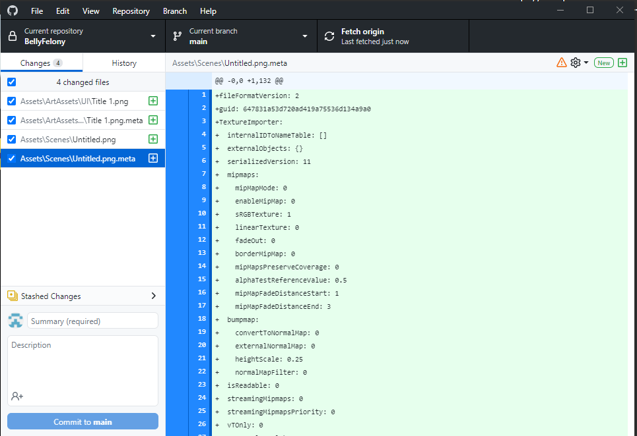
Step 1:
To start make sure you are not on the main branch.

Slide 10
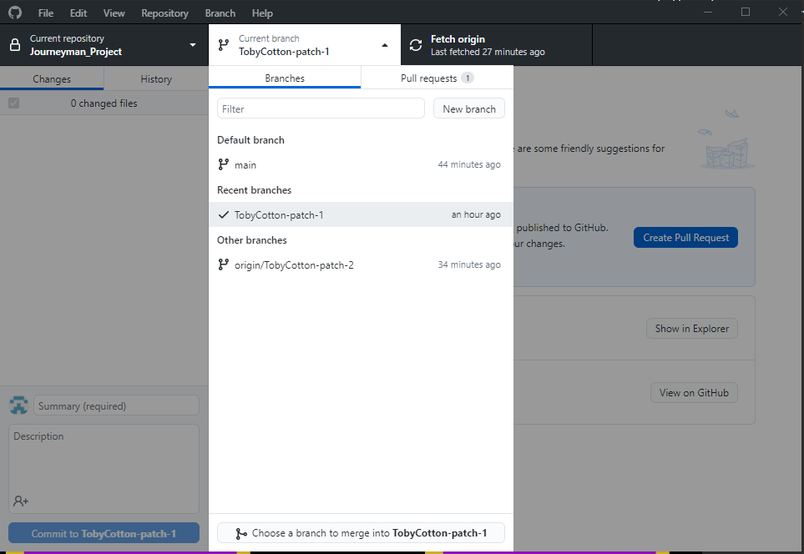
Step 2:
Create a new branch and name it after what you are doing.

Slide 11
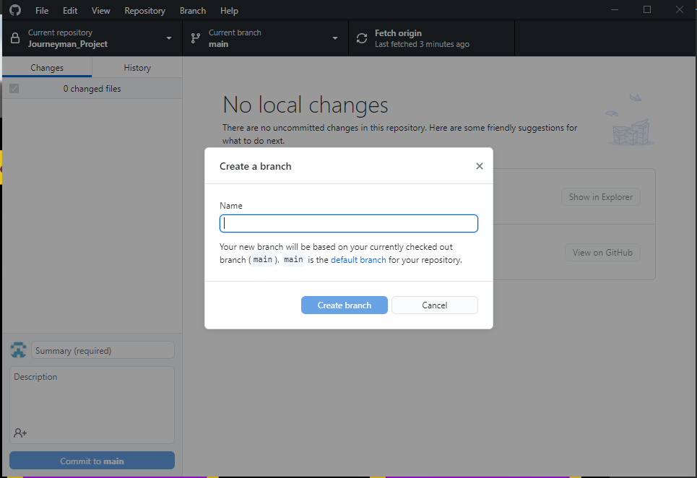
Step 3:
Give the branch a name.
If it asks you for a base select main.

Slide 12
Step 4:
If you need to access the GitHub files directly go to Documents/GitHub/Journeyman_Project

Slide 13
Step 5:
To upload files to the repository, you first need to name the commit.
The naming conversion for commits is, Student_Name_MainChange.
Example, A0052377_BenCanwell_CastleModel

Slide 14
Step 6:
After add a general description of what is in the commit.

Slide 15
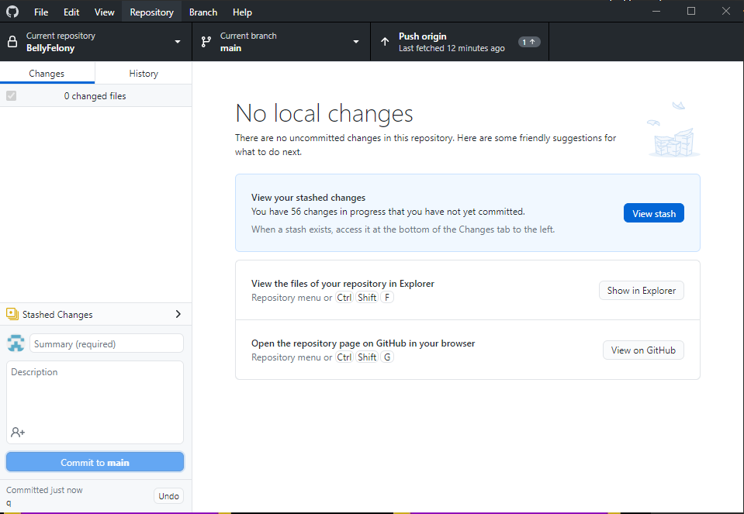
Step 7:
Then press push to origin so everyone can see the changes.
If for any reason you don't want to push the commit go to history right click the commit and press undo commit

Slide 16
Step 8:
To make sure you can see any future change press fetch origin and it will update to show if any new commits have been made

